Slide 1
Residential Rental Unit Permit Changes Update
City of Gainesville
Neighborhood Enhancement
(Code Enforcement)
August 2021

Slide 2
Information regarding the Residential Rental Unit Program, including this powerpoint, is available on the City of Gainesville website at http://www.cityofgainesville.org/CodeEnforcement/RentalHousingPermitsFees.aspx

Slide 3
On May 6th, The City Commission directed the City Attorney’s Office to amend the Residential Rental Unit Permit Ordinance to make several changes

Slide 4
Changes to Definitions
Regulated residentail rental unit
(or regulated unit) means a condominium, co-op, timeshare, quadraplex, triplex, duplex, or single-family dwelling that is not occupied by the owner and that is rented (whether for free, for charitable purposes, or in exchange for money or other consideration) in whole or in part (such as a room) to a person unrelated to the owner for periods of at least 30 consecutive days or one calendar month (whichever is less). This definition expressly excludes public lodging establishments regulated by the state pursuant to Part I of Chapter 509, Florida Statutes and dormitories.

Slide 5
Changes to Definitions
Occupant
means any person age 18 or older who resides in a regulated residential rental unit.

Slide 6
Changes to Definitions
Unrelated to the owner
means any person who is not interrelated to the owner as a spouse, domestic partner, child, foster child, parent, stepparent, foster parent, brother, sister, grandparent, grandchild, aunt, uncle, niece, nephew, father-in-law, mother-in-law, son-in-law, daughter-in-law, sister-in-law, brother-in-law, legal guardian, or domestic servant, as evidenced by written documentation of such relationship

Slide 7
Other changes: Clarified fireplaces in working condition must have working dampers, doors, and closures. If sealed, this is not required If an inspection is scheduled and no one is there to allow the inspection to take place, a fee of $100 will be charged.

Slide 8
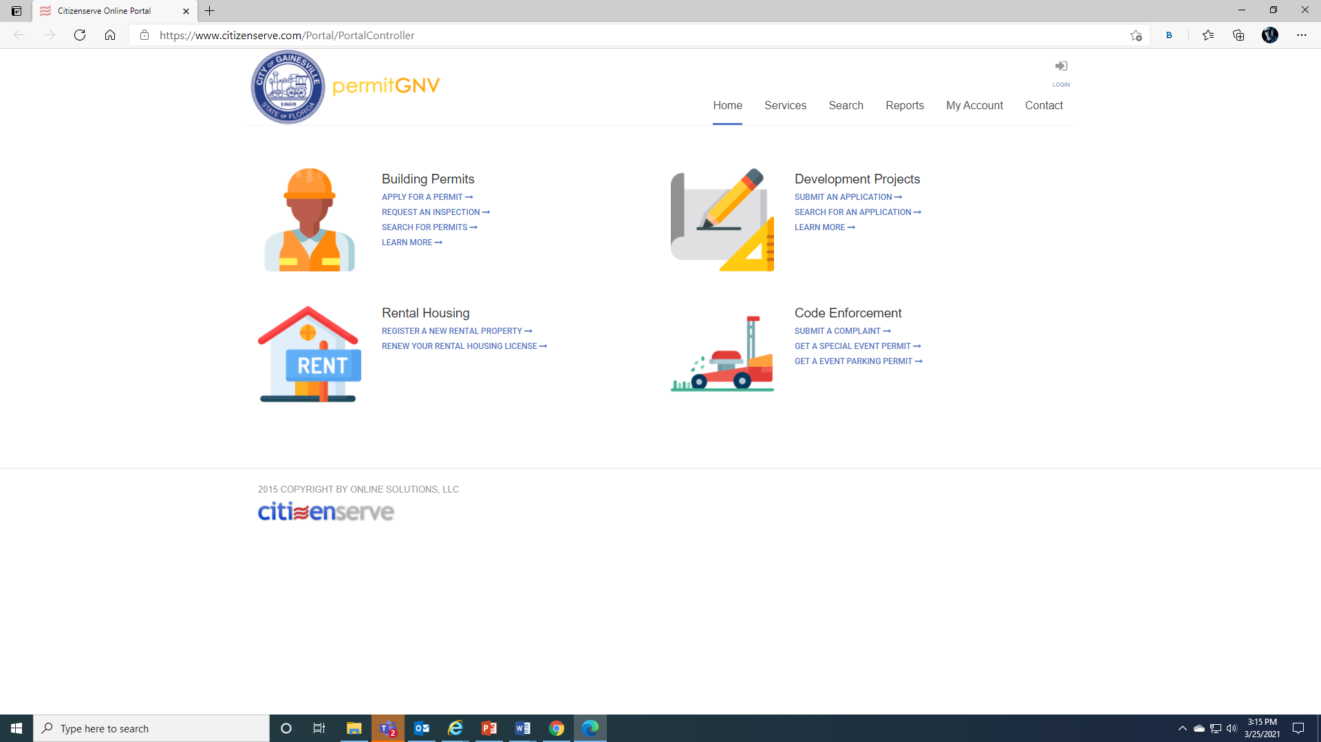

Slide 9
Shakayla Birch, Office of Equity and Inclusion

Slide 10
Thank You!
Any Questions?

