Slide 1
Residential Rental Unit Permit Changes
City of Gainesville
Neighborhood Enhancement
(Code Enforcement)
March 2021

Slide 2
Information regarding the Residential Rental Unit Program, including this powerpoint, is available on the City of Gainesville website at http://www.cityofgainesville.org/CodeEnforcement/RentalHousingPermitsFees.aspx

Slide 3
Definition of Regulated Residential Unit (or regulated unit)
Regulated Residential Unit
means a room or rooms located in a condominium, co-op, timeshare, quadraplex, triplex, duplex, or single-family dwelling that is rented, or advertised or held out to be rented, for periods of at least 30 consecutive days or one calendar month (whichever is less).
This definition expressly excludes public lodging establishments regulated by the state pursuant to F.S. Ch. 509, Pt. 1, and dormitories.

Slide 4
Residential Rental Unit Permit Cycle: At a Glance
Effective Date
When to Apply?
Effective date for new requirements is 10/1/2021, new Permit fee is $122
Application shall be made at least ten days prior to renting the unit
Permitting Cycle
Renewals?
Permitting cycles will now run from 10/1 to 9/30
Renewals shall be submitted on or before September 1st of each year

Slide 5
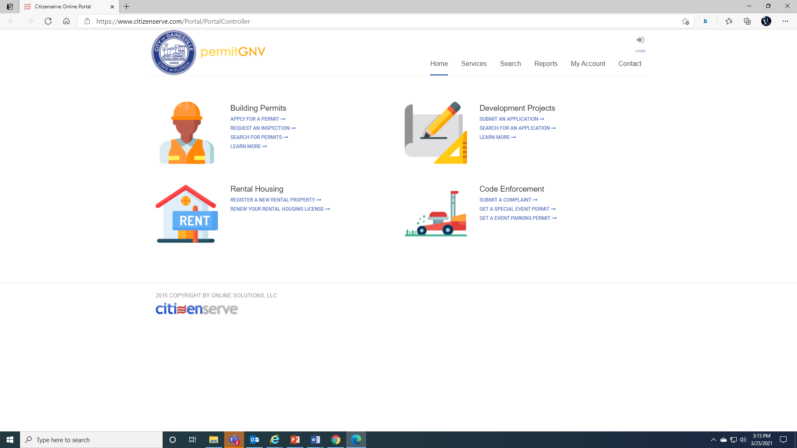

Slide 6
Residential Rental Unit Timeline – Effective Dates
IPMC
Effective
Date
5-year
Mark
Education and promote compliance
4-year rolling cycle of inspections (at least once every four years)
January 1st, 2021
October 1st, 2021
October 1st, 2026
All units must meet minimum IPMC standards https://codes.iccsafe.org/content/IPMC2018
Operable carbon monoxide alarm and working fire extinguisher
New requirements effective date
New energy efficiency standards
Compliance inspections begin
Expanded energy efficiency standards

Slide 7
Owners will be required to provide each occupant with a complete copy (hard or electronic) of the current version of:
Florida’s Landlord/Tenant Law
Tenant Bill of Rights and Responsibilities
U.S. Department of Energy Home Energy Score
Prepared by the City of Gainesville
Prepared by the City of Gainesville
https://betterbuildingssolutioncenter.energy.gov/home-energy-score
Brochure prepared by the Florida Department of Agriculture and Consumer Services
Owner shall:
Maintain a receipt signed by each occupant confirming they received the above documents
Provide a completed self-inspection checklist certifying that the regulated unit complies with the living standards
Provide a copy of the HVAC maintenance documentation
*if owner is not local, they must provide a local contact

Slide 8
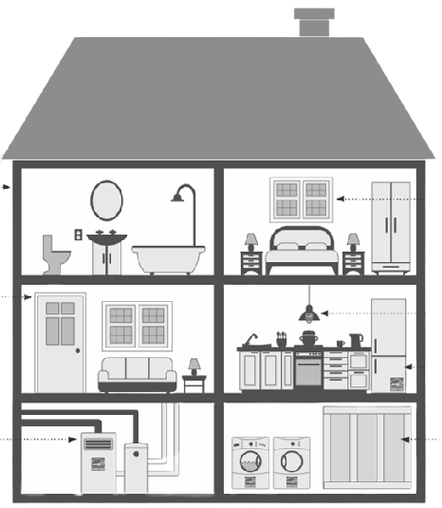
New Energy Efficiency Standards effective 10/1/2021
Attic
Chimney
R-19 insulation
Access must be weather stripped and insulated with minimum R-30
Fireplace chimneys must have working doors, dampers, or closures
Plumbing
Ducts
Must be free of visible leaks
Showerheads must be 2.2gal/min flow rate or less
Faucets must have aerators with 2.2gal/min flow rate or less
Toilets must be 3gal/flush or less
Visible duct joints must be sealed and insulated with minimum R-6
Water Heater
Visible and properly functioning temperature/pressure release valve (TPRV)
Pipes insulated for the first three feet from the unit (excluding gas units)
Visible exterior water lines not in enclosed space must be insulated
HVAC Systems
Must have maintenance performed by a currently licensed HVAC or mechanical contractor at least once within past 24 months
HVAC filter installed that is appropriately sized

Slide 9
New Energy Efficiency Standards effective 10/1/2026
Attic
Chimney
R-30 insulation
Access must be weather stripped and insulated with minimum R-30
Fireplace chimneys must have working doors, dampers, or closures
Plumbing
Ducts
Must be free of visible leaks
Showerheads must be 2.2gal/min flow rate or less
Faucets must have aerators with 2.2gal/min flow rate or less
Toilets must be 1.6gal/flush or less
Visible duct joints must be sealed and insulated with minimum R-6
Water Heater
Visible and properly functioning temperature/pressure release valve (TPRV)
Pipes insulated for the first three feet from the unit (excluding gas units)
Visible exterior water lines not in enclosed space must be insulated
HVAC Systems
Must have maintenance performed by a currently licensed HVAC or mechanical contractor at least once within past 24 months
HVAC filter installed that is appropriately sized
A programmable thermostat must be connected

Slide 10
Compliance Inspections starting on October 1st, 2021
4-year rolling cycle
Each regulated unit will be inspected at least once every four years for compliance
Every other Compliance Inspection
4yr
The City will prepare and provide to the owner a U.S. Department of Energy Home Energy Score for the regulated unit
Complaint-based Inspections
Inspections may be conducted more frequently and/or as a result of a complaint received by the City.
Notwithstanding the foregoing, the City will investigate complaints filed under the property maintenance code in accordance with the provisions therein.

Slide 11
If unit does not meet standards...
If upon inspection, the City Manager or designee, has reasonable grounds to believe that a regulated unit does not meet the living standard(s), the enforcement procedure set forth in Division 6 or Division 8 (as applicable) within article V of Chapter 2 of the Code of Ordinances will be utilized.
Revoke Permit
If living standard(s) are not corrected and such violation(s) constitute a health, safety, or welfare hazard to the occupant, the City Manager or designee may revoke the permit
A permit may not be issued, renewed, or transferred for a unit with uncorrected living standard violations

Slide 12
Failure to apply for a permit
If the City Manager or designee has reasonable grounds to believe that a regulated unit is occupied without a permit in violation of this article, the owner shall be sent a permit application and the owner shall, within 30 days of the date the permit application was sent, either:
Option A
Option B
Provide evidence that a permit is not required
Submit a complete permit application to the City
Failure to either provide evidence that a permit is not required or submit a complete permit application within 30 days of the date of the application was sent shall subject the owner(s) to a civil citation and/or the City may seek injunctive relief to prevent the unit from being rented.

Slide 13
Thank You!
Any Questions?

Slide 14
Residential Rental Unit Permit Changes
City of Gainesville
Neighborhood Enhancement (Code Enforcement)
March 2021

